Slide 1
Relational vs. Non-Relational Databases
Understanding the Differences, Characteristics, and Use Cases
Yusuf Babatunde Jubril
28th August 2024

Slide 2
What is a relational database?
A relational database is a collection of data that organizes data in tables and maintains relationships between the tables for information retrieval
A relational database management system (RDBMS) is computer software that enables users to create, modify, and analyze data in a relational database
Some of the most well-known RDBMSs include MySQL, PostgreSQL, MariaDB, Microsoft SQL Server, and Oracle Database.

Slide 3
Characteristics of Relational Databases
Structured data is data that has a standardized format for efficient access by software and humans alike. It is typically tabular with rows and columns that clearly define data attributes. Computers can effectively process structured data for insights due to its quantitative nature.
Examples of structured data include names, dates, addresses, credit card numbers, stock information, geolocation, and more.

Slide 4
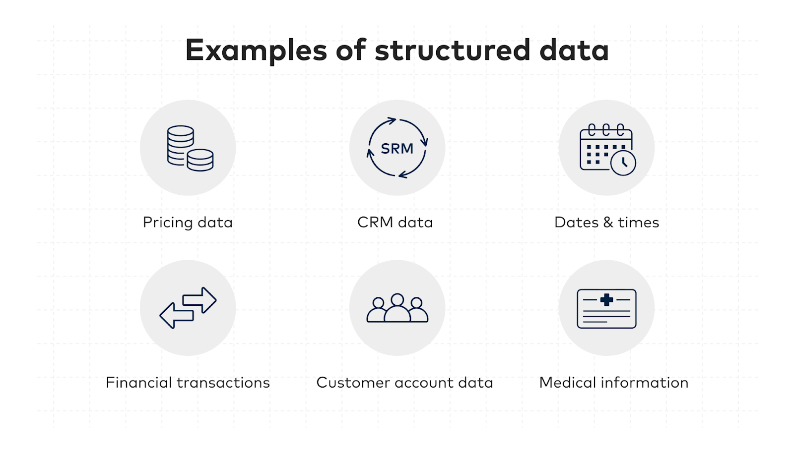

Slide 5
ACID stands for atomicity, consistency, isolation, and durability. It describes a set of expectations that ensure any database transactions are processed in a reliable way, resulting in correctness. A database is considered ACID-compliant when it meets these expectations or principles.
The four elements of ACID compliance ensure reliable database transactions:
Atomicity: All parts of a transaction must succeed or fail together, preventing partial transactions.
Consistency: Transactions must adhere to database rules, rolling back if they violate constraints.
Isolation: Transactions operate independently, avoiding interference with one another.
Durability: Once a transaction is completed, its changes are permanently saved, even in case of system failures.

Slide 6
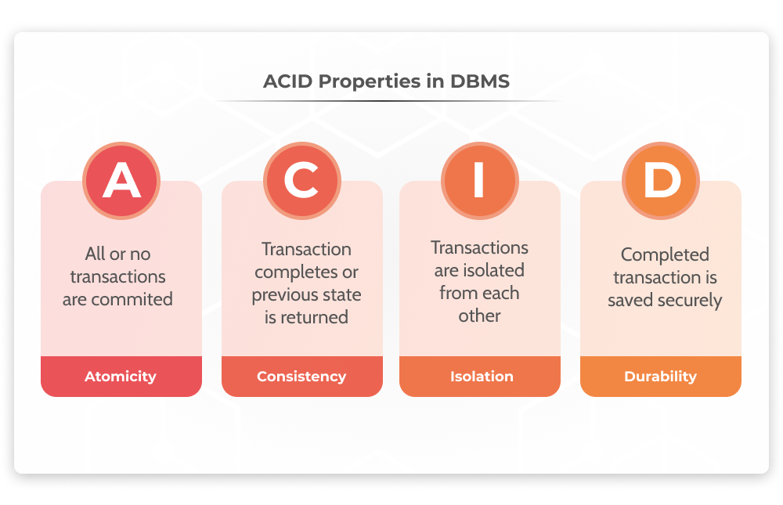

Slide 7
Advantages of Relational Databases
High Security: Relational databases enhance security by organizing data into tables and controlling access permissions, ensuring that unauthorized users cannot access sensitive information.
Data Integrity: They maintain accuracy through data validation and relationships, ensuring consistent and reliable data storage and retrieval, preventing data from being imperfect or isolated.
Flexibility: Relational databases can handle large amounts of data with ease, allowing users to add, update, or delete data without crashes, and they support unlimited tables, columns, and rows.
Easy Access to Data: SQL queries facilitate efficient data retrieval from well-organized tables, allowing users to access relevant information without complex navigation.
SQL: SQL allows for the management of data through queries for adding, updating, deleting, and retrieving information, aiding in analytics and transaction processing.

Slide 8
Use Cases For Relational Database
IT should never forget that technology is a means to an end, and not an end in itself. Technologies must be evaluated individually in terms of their ability to satisfy the needs of their respective users. IT should never be reluctant to use the most appropriate interface to satisfy users’ requirements. Attempting to force one technology or tool to satisfy a particular need for which another tool is more effective and efficient is like attempting to drive a screw into a wall with a hammer when a screwdriver is at hand: the screw may eventually enter the wall but at what cost? (E.F. Codd, et al. 1998)

Slide 9
What is a Non-Relational Database?
A non-relational database is a database that does not use the tabular schema of rows and columns found in most traditional database systems. Instead, non-relational databases use a storage model that is optimized for the specific requirements of the type of data being stored.
For example, data may be stored as simple key/value pairs, as JSON documents, or as a graph consisting of edges and vertices.

Slide 10
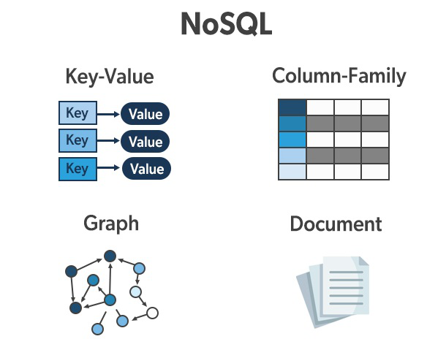

Slide 11
Characteristics of Non-Relational Databases
Flexible Schema: Dynamic or Schema-Less Data Models
Flexible Schema: In traditional relational databases, the schema (structure of data) must be predefined and strictly followed, meaning any change to the structure, such as adding a new column, requires alterations to the database schema. In contrast, databases with flexible schemas, such as many non-relational (NoSQL) databases, allow for a more dynamic approach.
Dynamic Schema: These databases permit different records (or documents) to have different fields or attributes. For example, one record might have a field for "address" while another might not. This flexibility supports rapid changes and evolution of data models without needing to redefine the entire schema.
Schema-Less Models: Some NoSQL databases do not require any predefined schema at all. This allows for even greater flexibility, as data can be stored in any format, and new types of data can be introduced without impacting existing data or requiring significant structural changes.

Slide 12
High Performance for Unstructured Data Optimized Storage:
Efficiently stores unstructured data like JSON, logs, and multimedia files without requiring a fixed schema.
Flexible Indexing & Querying: Supports advanced indexing for quick retrieval of diverse data types, enabling real-time analysis.
Scalable: Designed to scale horizontally, maintaining performance as data volume grows.
Real-Time Processing: Capable of ingesting and analyzing data streams in real time, crucial for monitoring and immediate insights.
Example: ElasticSearch – excels in indexing and searching vast amounts of log data, enabling real-time log analysis and monitoring.

Slide 13
Advantages of Non-Relational Databases
Eases Application Development: NoSQL databases streamline development by using formats like JSON, aligning data storage with application structures, and minimizing the need for data transformation. This simplifies storing and retrieving data, reduces reliance on ETL processes, and leverages a strong developer community for support.
Flexible Data Model: NoSQL databases offer flexibility by allowing data to be stored in formats that mirror application usage, without requiring a fixed schema. This adaptability supports a variety of data types and enables easy schema adjustments, facilitating efficient handling of diverse and evolving data.
Scale-Out Architecture: NoSQL databases scale horizontally by distributing data across multiple servers, allowing capacity to be increased by adding more machines. This design is ideal for handling large datasets and high traffic, especially in cloud environments where resources can be dynamically adjusted.
Cloud-Friendly: NoSQL databases are optimized for cloud environments, supporting dynamic scaling to handle large datasets and high traffic. They enable seamless expansion and contraction of resources and allow for upgrades or changes with minimal downtime, ensuring high availability and flexibility.

Slide 14
Use Cases For Non-Relational Database
Big data analytics has become a crucial tool for companies seeking to gain insights into their operations, customers, and markets. However, traditional relational databases are often not well-suited for big data analytics because they struggle to handle large volumes of unstructured data.
This is where NoSQL databases come in. NoSQL databases are designed to handle large volumes of unstructured data, making them an excellent choice for big data analytics. Whether it's text data, sensor data, or multimedia data, NoSQL databases can handle it all, providing fast and flexible access to data.
One of the primary advantages of NoSQL databases for big data analytics is their ability to handle large volumes of data. NoSQL databases can scale horizontally, allowing companies to add more computing power and storage as needed. This scalability means that NoSQL databases can handle even the largest data sets, providing fast and efficient data access.
NoSQL databases also offer flexible data models, which is essential for big data analytics. In traditional relational databases, data must be organized into a rigid structure, which can be limiting when dealing with unstructured data. NoSQL databases, on the other hand, can handle a variety of data models, including key-value, document, and graph models. This flexibility means that companies can store and analyze data in a way that best suits their needs.

Slide 15
References
E.F. Codd, et al. 1998. “Providing Olap to User-Analysts: An It Mandate.” https://bit.ly/2Okyz2H.
Rachelle, 2023. “What Is RDBMS And How It’s Different From DBMS?” https://www.redswitches.com/blog/relational-database-management-systems/
A. Aisha, June 28, 2024. “What are the Main Advantages of Relational Database Model?” https://hapy.co/journal/advantages-of-relational-database/#advantages-of-relational-database
April 04, 2023. “Real-World NoSQL Database Use Cases: Examples and Use Cases for Developers.” https://www.datastax.com/guides/nosql-use-cases
P. Devin. May 3, 2023. “Structured vs. Unstructured Data: What's the Difference?” https://www.g2.com/articles/structured-vs-unstructured-data

